Slide 1


Slide 2
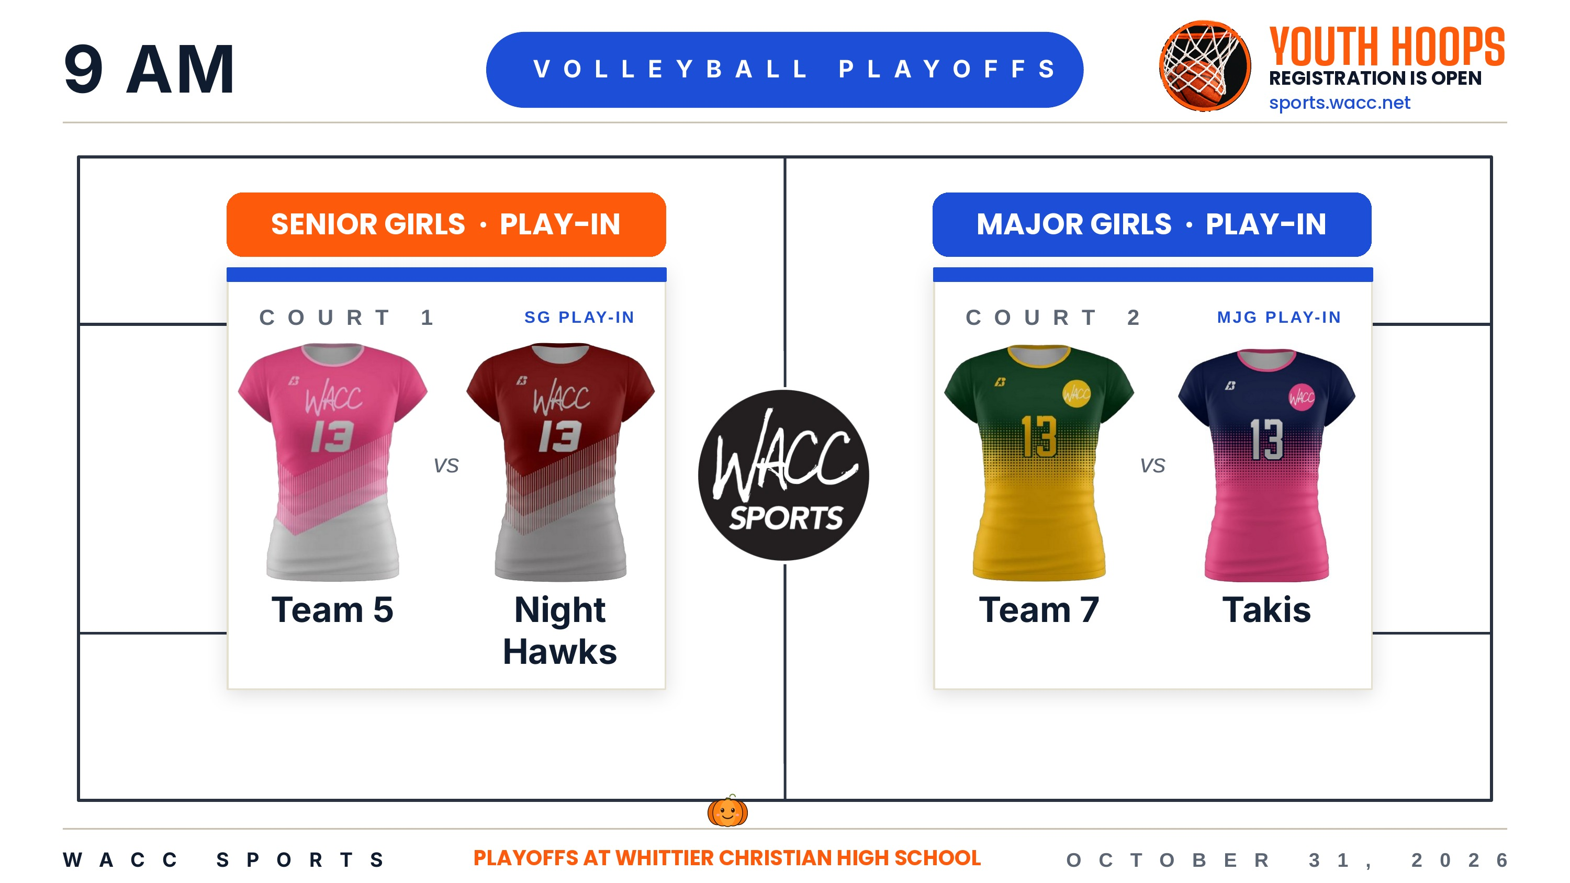

Slide 3
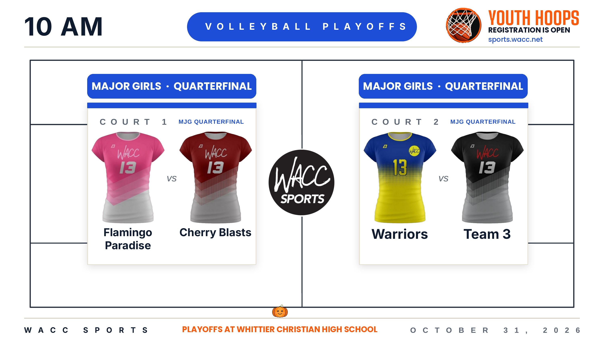

Slide 4
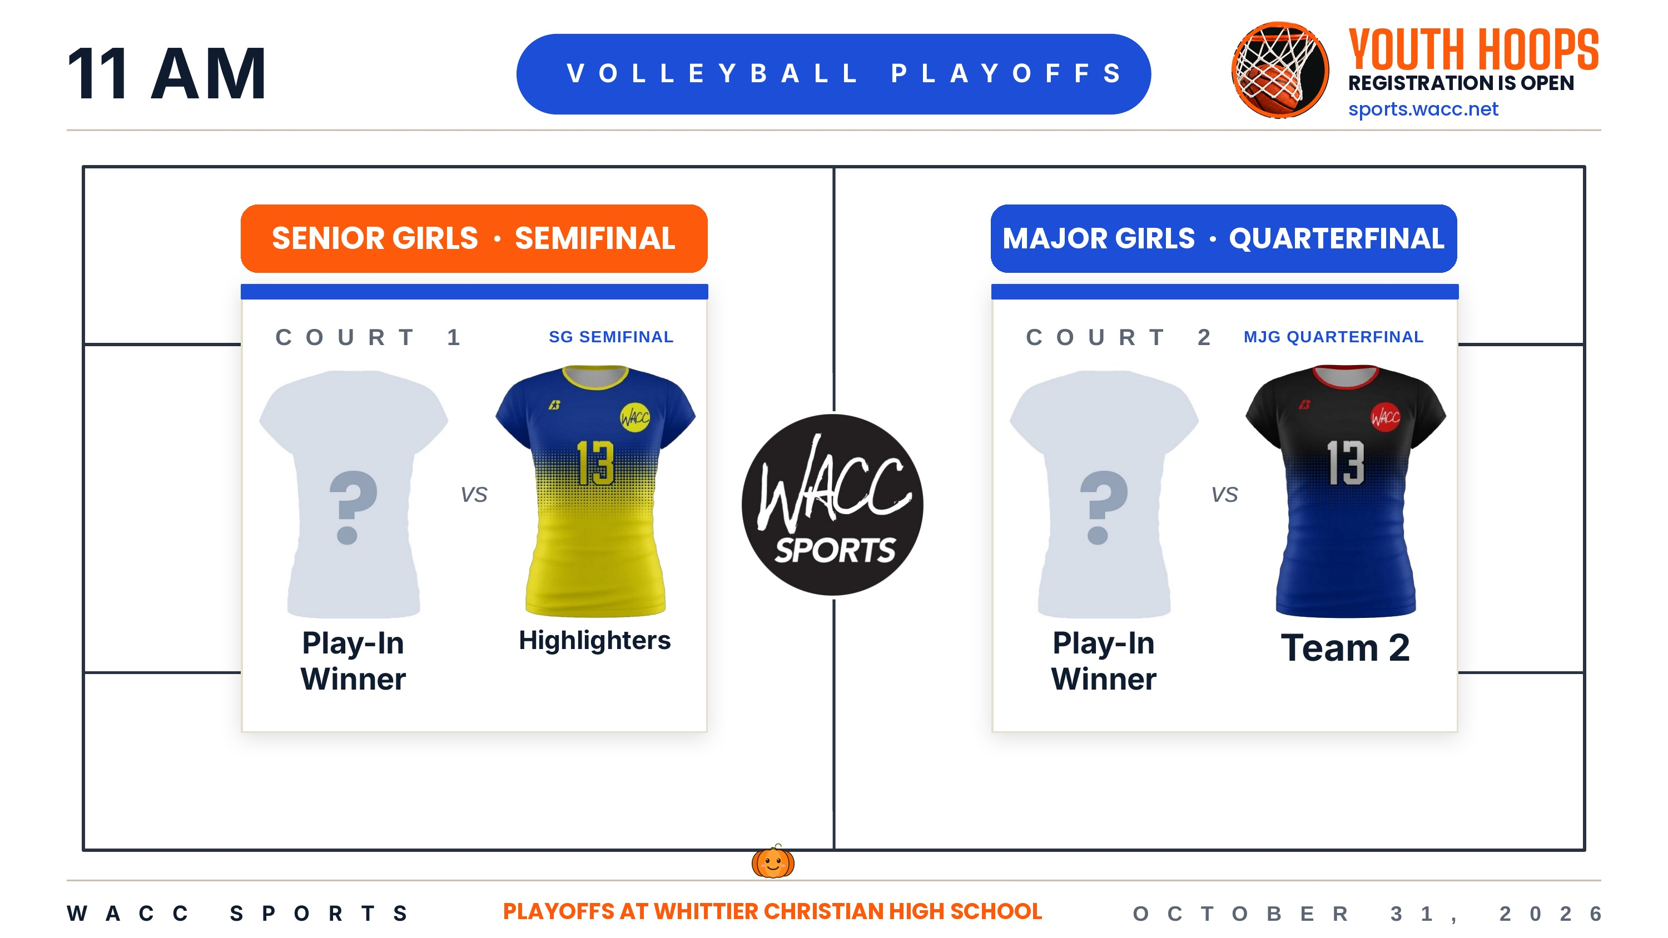
Night Hawks
Team 7

Slide 5
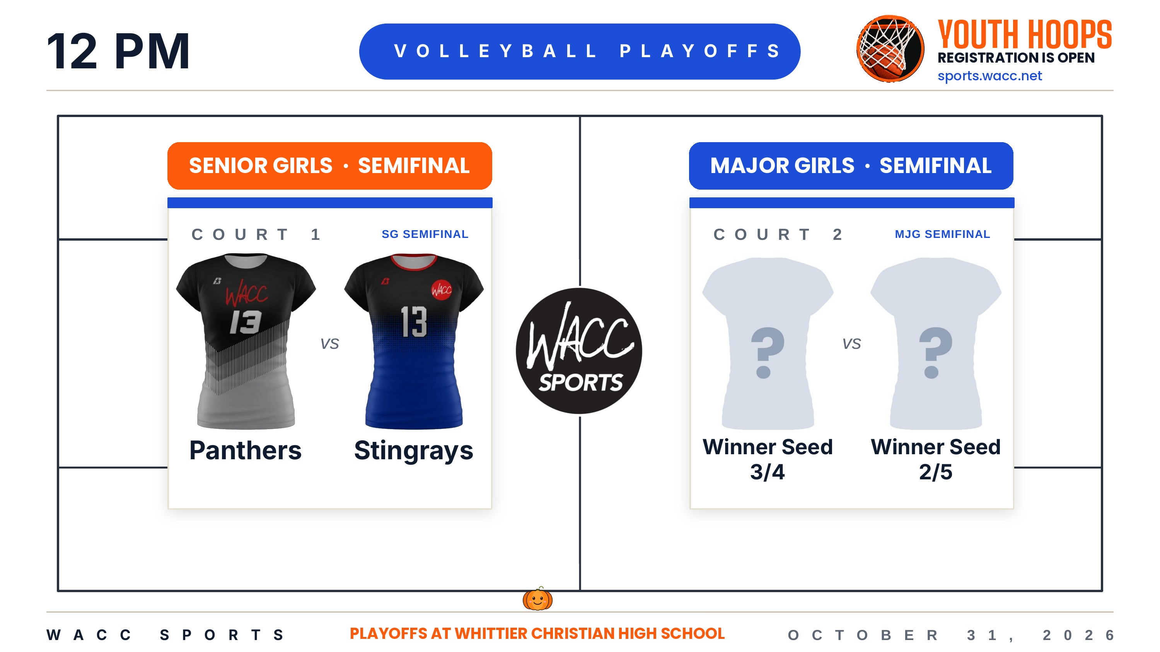
Cherry Blasts
Warriors

Slide 6


